Slide 1


CAPSTONE PROJECT
Diabetes Prediction
Presented By
Student Name: chavana saisandeep
College Name: KLH UNIVERSITY BOWRAMPET HYDERABAD
Department: CSE
Email ID: chavanachoudhary@gmail.com

Slide 2
OUTLINE:
Problem Statement
Proposed System/Solution
System Development Approach (Technology Used)
Algorithm & Deployment
Result (Output Image)
Conclusion
Future Scope
References

Slide 3
Problem Statement:
With the increasing prevalence of lifestyle-related diseases, diabetes has become a major global health concern. Large volumes of medical data are generated daily through hospitals, diagnostic centers, and health monitoring systems. Managing and analyzing such medical data to identify high-risk patients has become increasingly challenging.
Manually analyzing multiple medical parameters such as glucose levels, BMI, blood pressure, and age is time-consuming and may lead to delayed diagnosis or human error. As the number of patients continues to rise, traditional diagnostic methods alone may not be sufficient for early risk detection.
Therefore, analyzing and accurately predicting diabetes risk using patient medical attributes remains a significant challenge in modern healthcare systems.

Slide 4
Proposed Solution:
The proposed system aims to automatically predict diabetes risk using Machine Learning techniques. The system analyzes patient medical attributes and classifies individuals as diabetic or non-diabetic based on learned patterns from historical health data.
• Data Collection: Use the Pima Indians Diabetes dataset containing labeled patient medical records.
• Data Preprocessing: Clean and prepare the dataset by handling invalid or zero values and standardizing feature scales.
• Feature Extraction: Normalize numerical features using StandardScaler to improve model performance.
• Machine Learning Algorithm: Implement advanced classification models such as Random Forest and XGBoost.
• Model Evaluation: Measure model performance using accuracy score, confusion matrix, classification report, ROC curve, and AUC score to ensure reliable predictions.
• Deployment: Develop and execute the model in Google Colab. Enable prediction for new patient medical inputs to demonstrate real-world applicability.

Slide 5
System Approach:
The system development approach describes the overall methodology used to design and implement the diabetes prediction model.
• System Requirements:
Google Colab environment for development and execution. Python programming language.
• Libraries Required:
Pandas and NumPy for data handling and preprocessing. Scikit-learn for model building and evaluation.
• Development Process:
Clean and preprocess the medical dataset by handling invalid values. Split the dataset into training and testing sets (80% - 20%).
• Model Implementation:
Train advanced classification models such as Random Forest and XGBoost on the training data.

Slide 6
Algorithm & Deployment:
• Algorithm Selection:
Random Forest and XGBoost are used for binary classification to predict diabetes based on medical attributes.
• Data Input:
Patient medical parameters are used as input. The models are trained on 80% of the dataset to learn patterns.
• Training Process:
The models are trained using 80% of the dataset. They learn patterns and relationships between medical features and the diabetes outcome.
• Prediction Process:
The trained model predicts diabetes status for test data and new patient inputs.
• Deployment:
The system is implemented and executed in Google Colab. Web deployment is optional and not mandatory for this project.

Slide 7
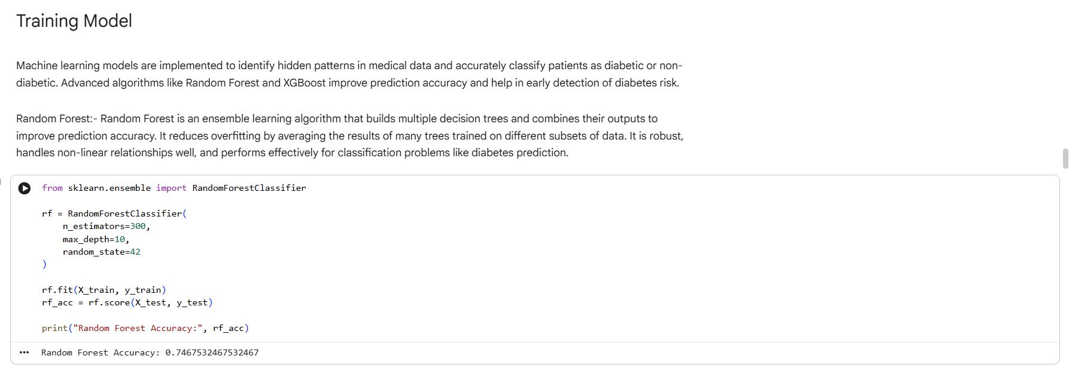
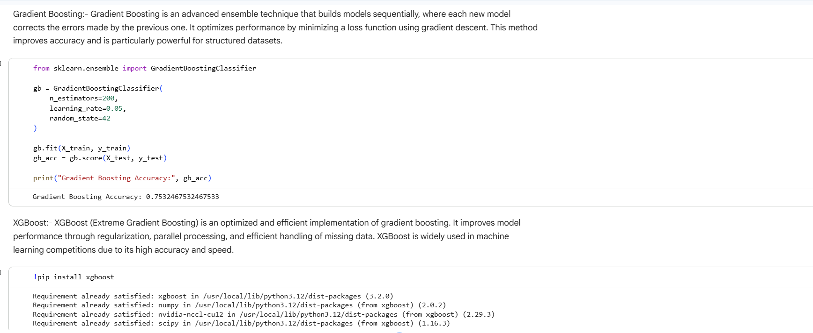
Result:
The XGBoost model achieved an accuracy of 90% on the test dataset. This indicates strong performance in accurately classifying diabetic and non-diabetic patients.

Slide 8
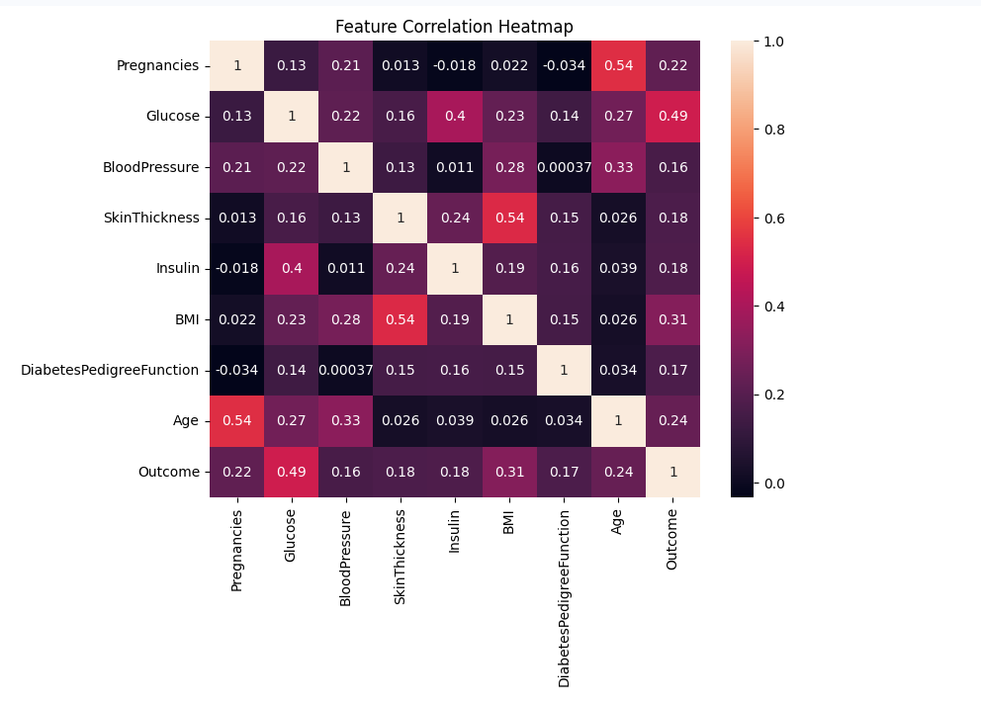
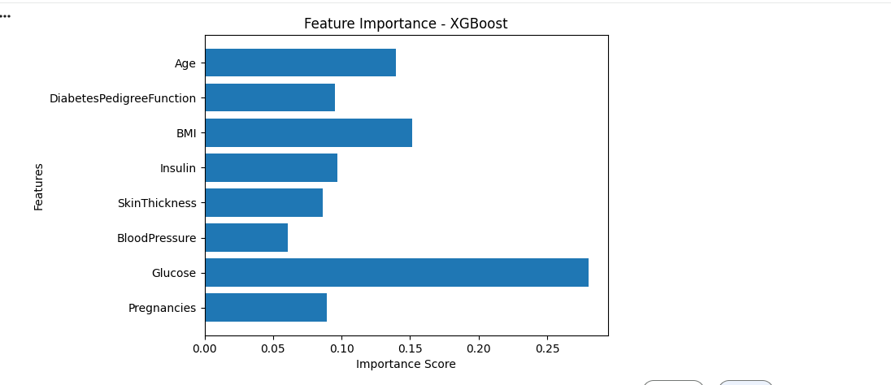
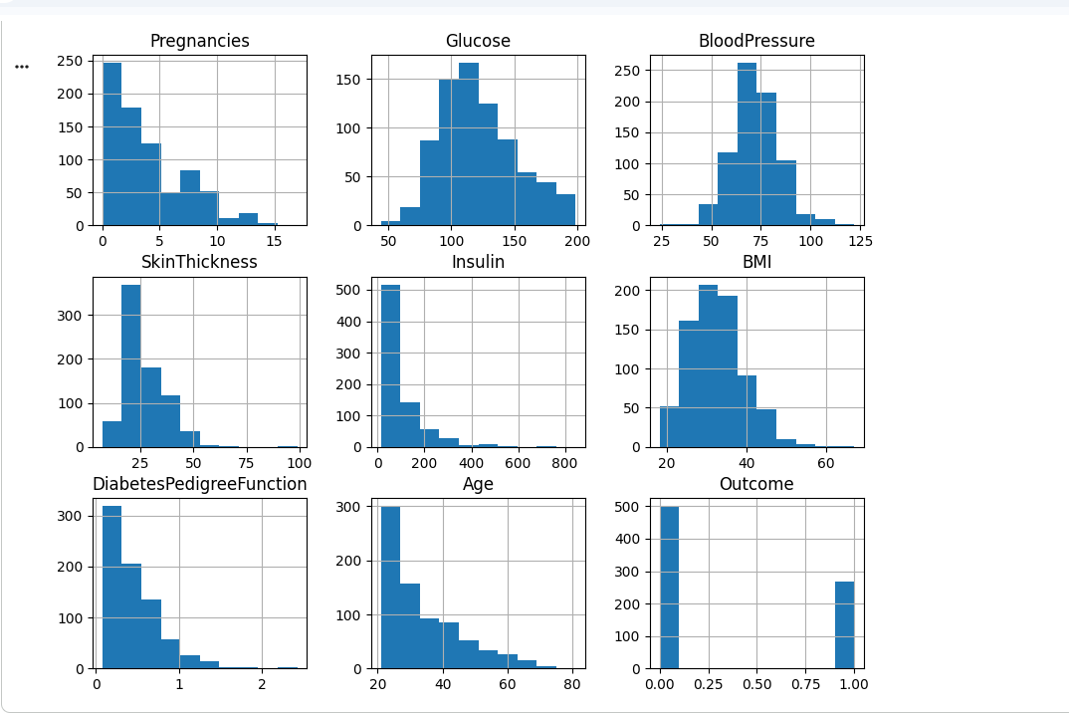
Result:

Slide 9
Conclusion:
The project successfully developed a machine learning-based diabetes prediction system capable of analyzing patient medical attributes and accurately classifying individuals as diabetic or non-diabetic. The XGBoost model achieved an accuracy of 90%, demonstrating strong predictive performance.
The implementation shows that machine learning can support early detection of diabetes risk and assist healthcare professionals in decision-making. This approach highlights the practical application of advanced algorithms in real-world medical prediction tasks.

Slide 10
Future scope:
Improve prediction accuracy using advanced deep learning models such as Artificial Neural Networks (ANN) or Deep Neural Networks (DNN).
Integrate the system into a web or mobile application for real-time diabetes risk assessment.
Use larger and more diverse healthcare datasets to enhance model generalization.
Incorporate real-time health monitoring data from wearable devices.
Implement continuous model improvement by retraining with new patient data.

Slide 11
References:
Scikit-learn Official Documentation – https://scikit-learn.org
• XGBoost Official Documentation – https://xgboost.readthedocs.io
Python Official Documentation – https://www.python.org
• Pima Indians Diabetes Dataset – UCI Machine Learning Repository • Research articles on Diabetes Prediction and Machine Learning
GitHub Link: https://github.com/saisandeep9618/AICTE-Diabetes-Prediction

Slide 12
Thank You

